Slide 1
Section 9.4: Cross Products

Slide 2
Definition
The cross product of < v1, v2, v3> and <w1, w2, w3> is

Slide 4
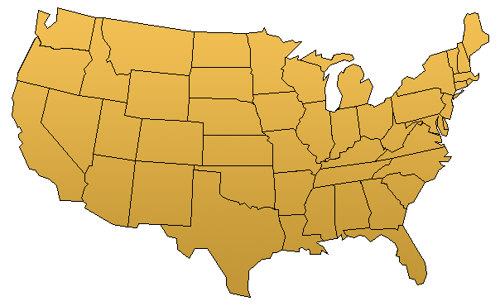

Slide 6
Properties

Slide 7
w
v
w
v

Slide 8
v
w
u

Slide 9
Torque
Suppose P is rotating around the point O and a force F acts on P tangentially.
F
P
O

